Slide 1
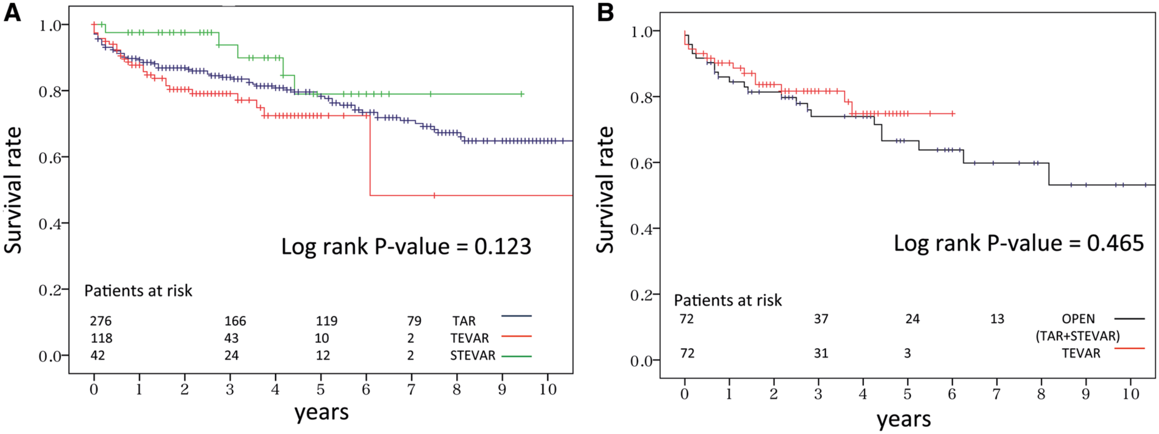
From: Comparison of aortic arch repair using the endovascular technique, total arch replacement and staged surgery†
Eur J Cardiothorac Surg. 2017;51(6):1142-1148. doi:10.1093/ejcts/ezx028
Eur J Cardiothorac Surg | © The Author 2017. Published by Oxford University Press on behalf of the European Association for Cardio-Thoracic Surgery. All rights reserved.
Notes:
Figure 1: Survival curve: (A) for unmatched patients, (B) for patients after propensity matching.

